Slide 1
ATAI
Advanced Techniqueof Artificial Intelligence
ATAI
ChongqingUniversity _{AdvancedTechniqueof}
of Technology Artificial Intelligence
Chongqing University of
Technology
Chongqing University ^{ATAI}
_{of Technology} Advanced Techniqueof
Artificial Intelligence
Chongqing University of Technology
Chongqing University of Technology
Multimodality Invariant Learning for
Multimedia-Based New Item Recommendation
Code: https://github.com/HaoyueBai98/MILK.
2024.7. 4•ChongQing
—— SIGIR 2024
Reported by Ling Tan
1

Slide 2
ATAI
AdvancedTechniqueof
Artificial Intelligence
ATAI
ChongqingUniversity _{AdvancedTechniqueof}
of Technology Artificial Intelligence
ChongqingUniversity of Technology
Motivation
（1） First, a huge number of new items emerge rapidly over time, particularly on the news and short-video sharing platforms.When faced with new items, most models need to be retrained on new items, which could not satisfy the quick adaption to new items at the inference stage
（2） Second, real-world items exhibit varying degrees of modality missingness.Nearly all previous works relied on modality completeness for recommendation or simply tackled this issue with preprocessing techniques to impute missing modalities.

Slide 3
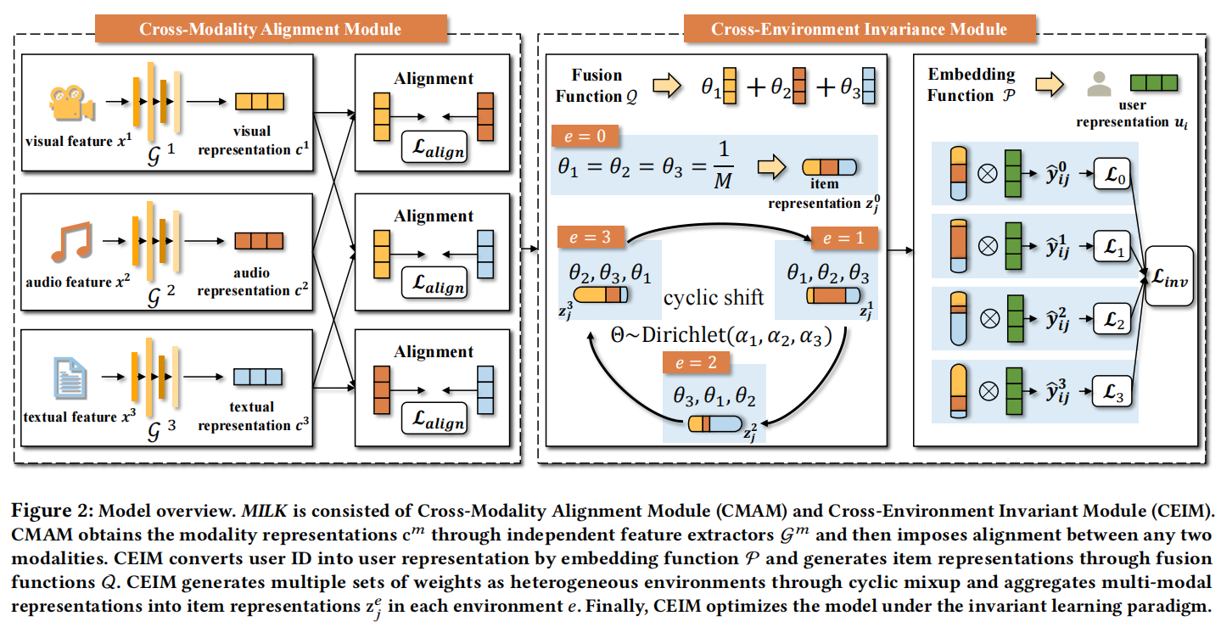
ChongqingUniversity of Technology
ATAI
AdvancedTechniqueof
Artificial Intelligence
ATAI
ChongqingUniversity _{AdvancedTechniqueof}
of Technology Artificial Intelligence
Overview

Slide 4
ChongqingUniversity of Technology
ATAI
AdvancedTechniqueof
Artificial Intelligence
ATAI
ChongqingUniversity _{AdvancedTechniqueof}
of Technology Artificial Intelligence
Method

Slide 5
ChongqingUniversity of Technology
ATAI
AdvancedTechniqueof
Artificial Intelligence
ATAI
ChongqingUniversity _{AdvancedTechniqueof}
of Technology Artificial Intelligence
Method

Slide 6
ChongqingUniversity of Technology
ATAI
AdvancedTechniqueof
Artificial Intelligence
ATAI
ChongqingUniversity _{AdvancedTechniqueof}
of Technology Artificial Intelligence
Method

Slide 7
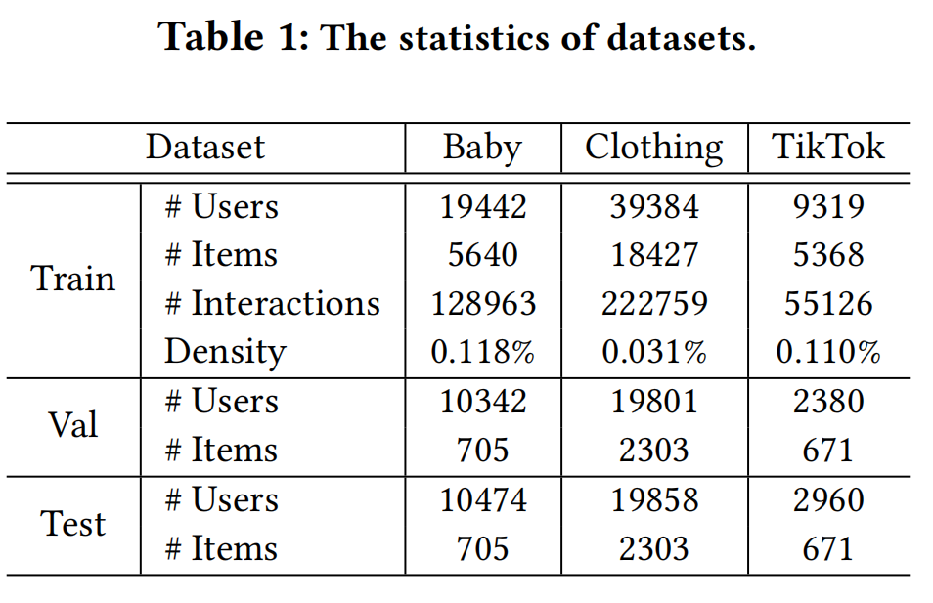
ATAI
AdvancedTechniqueof
Artificial Intelligence
ATAI
ChongqingUniversity _{AdvancedTechniqueof}
of Technology Artificial Intelligence
ChongqingUniversity of Technology
Experiments

Slide 8
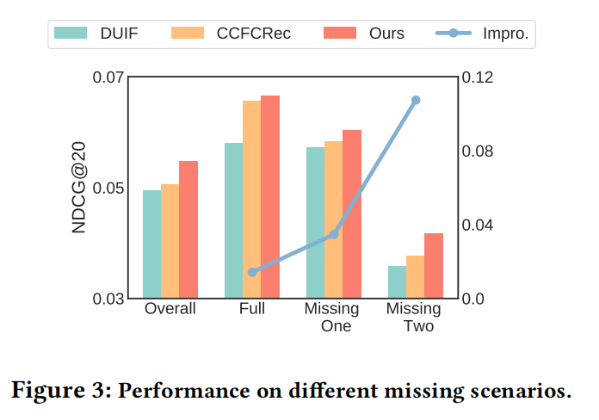
ATAI
AdvancedTechniqueof
Artificial Intelligence
ATAI
ChongqingUniversity _{AdvancedTechniqueof}
of Technology Artificial Intelligence
ChongqingUniversity of Technology
Experiments

Slide 9
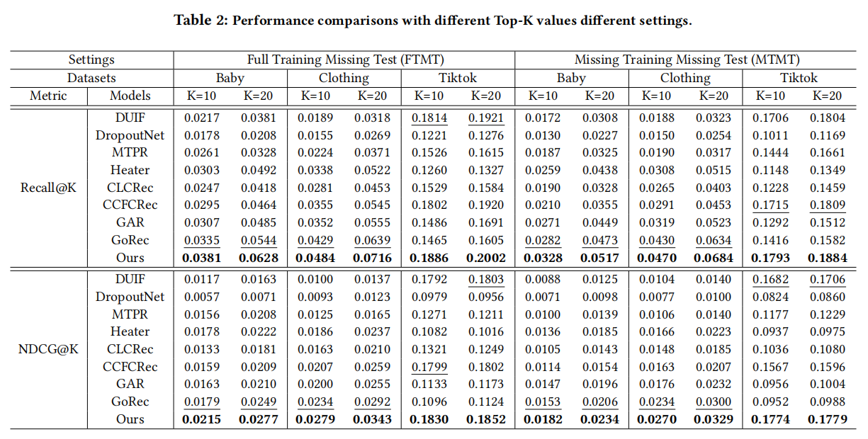
ATAI
AdvancedTechniqueof
Artificial Intelligence
ATAI
ChongqingUniversity _{AdvancedTechniqueof}
of Technology Artificial Intelligence
ChongqingUniversity of Technology
Experiments

Slide 10
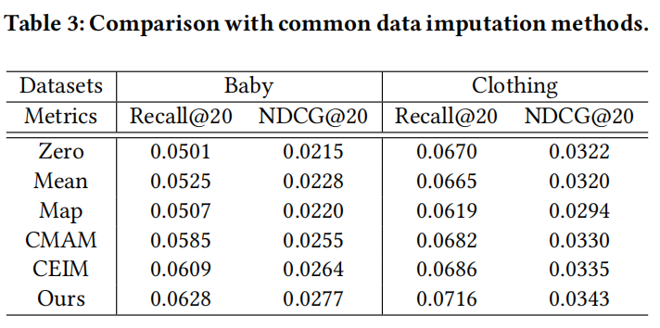
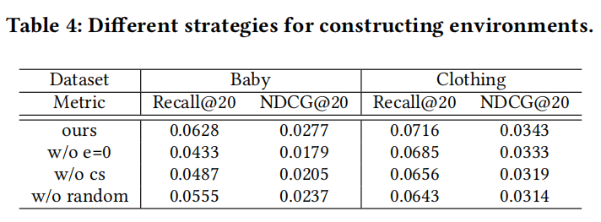
ATAI
AdvancedTechniqueof
Artificial Intelligence
ATAI
ChongqingUniversity _{AdvancedTechniqueof}
of Technology Artificial Intelligence
ChongqingUniversity of Technology
Experiments

Slide 11
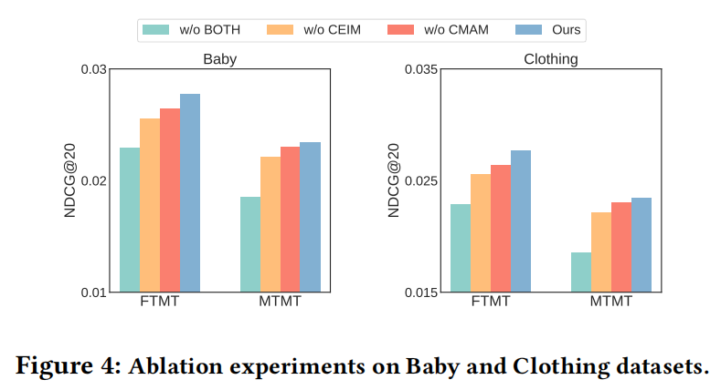
ATAI
AdvancedTechniqueof
Artificial Intelligence
ATAI
ChongqingUniversity _{AdvancedTechniqueof}
of Technology Artificial Intelligence
ChongqingUniversity of Technology
Experiments

Slide 12
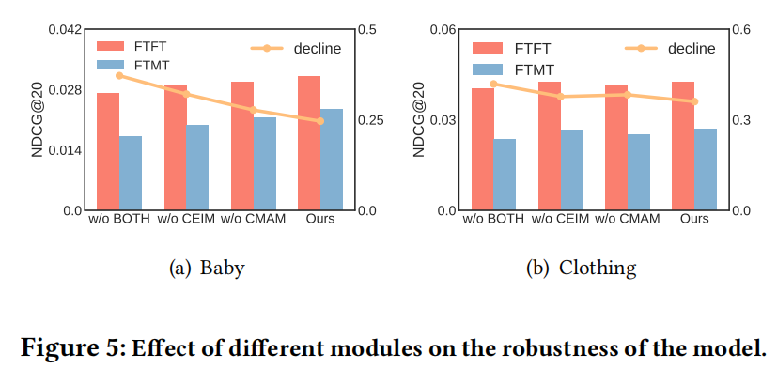
ATAI
AdvancedTechniqueof
Artificial Intelligence
ATAI
ChongqingUniversity _{AdvancedTechniqueof}
of Technology Artificial Intelligence
ChongqingUniversity of Technology
Experiments

Slide 13
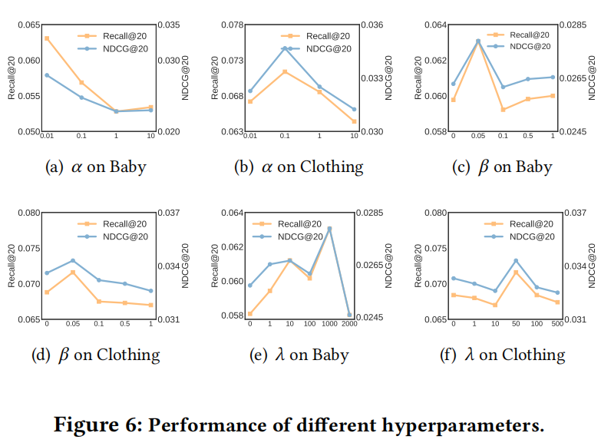
ATAI
AdvancedTechniqueof
Artificial Intelligence
ATAI
ChongqingUniversity _{AdvancedTechniqueof}
of Technology Artificial Intelligence
ChongqingUniversity of Technology
Experiments

Slide 14
ChongqingUniversity of Technology
ATAI
AdvancedTechniqueof
Artificial Intelligence
ATAI
ChongqingUniversity _{AdvancedTechniqueof}
of Technology Artificial Intelligence
Thanks!

